Slide 1
Facial Emotion Recognition with Facial Gestures
By-Siddharth Patel

Slide 2

Why Emotion Detection?
The motivation behind choosing this topic specifically lies in the huge investments large corporations do in feedbacks and surveys but fail to get equitable response on their investments.
Emotion Detection through facial gestures is a technology that aims to improve product and services performance by monitoring customer behavior to certain products or service staff by their evaluation

Slide 3



Some Companies that make us of emotion detection...
While Disney uses emotion-detection tech to find out opinion on a completed project, other brands have used it to directly inform advertising and digital marketing.
Kellogg’s is just one high-profile example, having used Affectiva’s software to test audience reaction to ads for its cereal
Unilever does this, using HireVue’s AI-powered technology to screen prospective candidates based on factors like body language and mood. In doing so, the company is able to find the person whose personality and characteristics are best suited to the job.

Slide 4
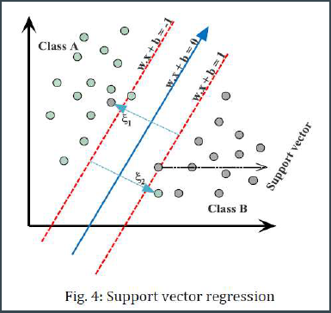
Emotion Expression Recognition Using SVM
What are Support Vector Machines?
SVMs plot the training vectors in high-dimensional
feature space, and label each vector with its class. A hyperplane is drawn between the training vectors that maximizes the distance between the different classes. The hyperplane is determined through a kernel function (radial basis, linear, polynomial or sigmoid), which is given as input to the classification software. [1999][Joachim’s, 1998b].

Slide 5
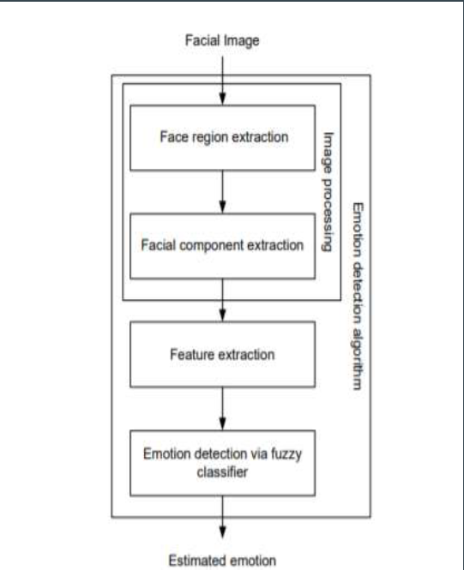
Facial Expression Detection using Fuzzy Classifier
The algorithm is composed of three main stages: image processing stage and facial feature extraction stage, and emotion detection stage.
In image processing stage, the face region and facial component is extracted by using fuzzy color filter, virtual face model, and histogram analysis method
The features for emotion detection are extracted from facial component in facial feature extraction stage

Slide 6
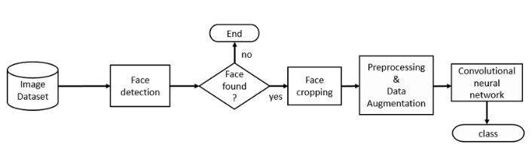
Facial Emotion Recognition by CNN
Data Pre-processing. 4.Training.
Image Augmentation. 5.Validation.
Feature Extraction. 6.Emotion Detection.

Slide 7
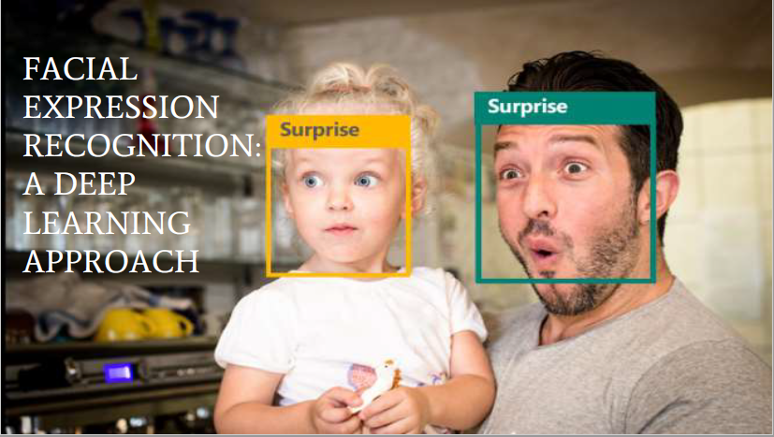

Slide 8
Dataset Description
The data consists of 48x48 pixel grayscale images of faces. The faces have been categorized into facial expression in to one of seven categories (0=Angry, 1=Disgust, 2=Fear, 3=Happy, 4=Sad, 5=Surprise, 6=Neutral).
The training set consists of 28,709 examples. The public test set used for the leaderboard consists of 3,589 examples. The final test set, which was used to determine the winner of the competition, consists of another 3,589 examples. This dataset was prepared by Pierre-Luc Carrier and Aaron Courville, as part of an ongoing research project.

Slide 9
Data Pre-processing
The fer2013.csv consists of three columns namely emotion, pixels and purpose.
● The column in pixel first of all is stored in a list format.
● Since computational complexity is high for computing pixel values in the range of
(0-255), the data in pixel field is normalized to values between [0-1].
● The face objects stored are reshaped and resized to the mentioned size of 48 X 48.
● The respective emotion labels and their respective pixel values are stored in
objects.
● We use scikit-learn’s train_test_split() function to split the dataset into training
and testing data. The test_size being 0.2 meaning, 20% of data is for validation
while 80% of the data will be trained

Slide 10
References
For Data-Sets
https://www.Kaggle.com
https://www.engineersgarage.com/articles/image-processing-tutorial-applications
https://docs.python.org/2/library/glob.html
https://opencv.org
http://docs.python.org/3.4/library/random.html

